Slide 1

Cloud Peak
Forecasts at a glance – A Live Weather App

Slide 2

Visit the Site
Explore the live app here: Cloud peak

Slide 3

Features
- Real-time weather search - Popular city cards - Animated alerts and UI - Responsive design - Smart city suggestions - Floating label search input

Slide 4




Technologies
JavaScript & Json CSS & HTML OpenWeatherMap API

Slide 5
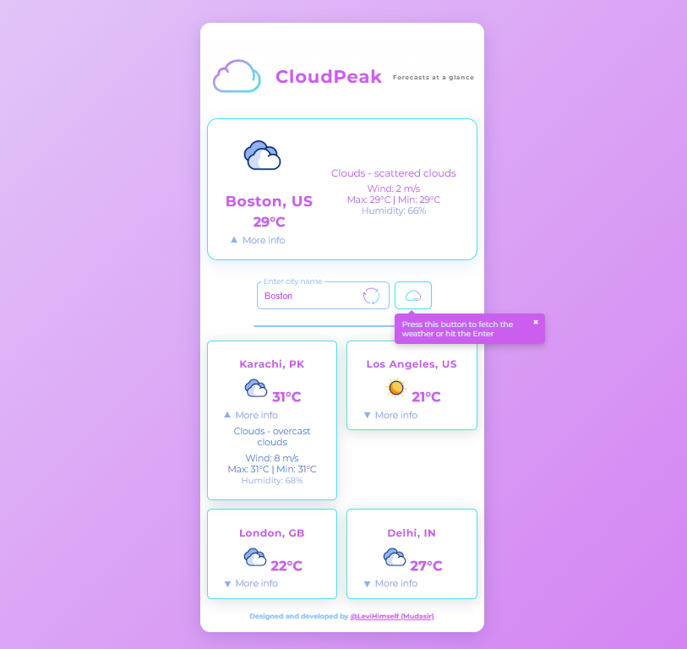

Preview
Live view

Slide 6

Structure
CloudPeak/
├── assets/
│ ├── icons/
│ └── js/
│ └── styles.css
├── node_modules/
├── favicon.ico
├── index.html
├── license
├── package-lock.json
├── package.json
├── Preview2.PNG
├── README.md
├── robots.txt
└── sitemap-index.xml

Slide 7
API Info
Uses OpenWeatherMap API​ Make sure to add your API key in app.js​ Example:​ const API_KEY = 'YOUR_API_KEY';​

Slide 8

Future Updates
Add 5-day weather forecast for all cities.
Forecast charts & detailed data

Slide 9

Credits
Weather Data: OpenWeatherMap
Icons: Lordicon

Slide 10

Thank you
Github: @LevyMaze Site address: CloudPeak

